Slide 1
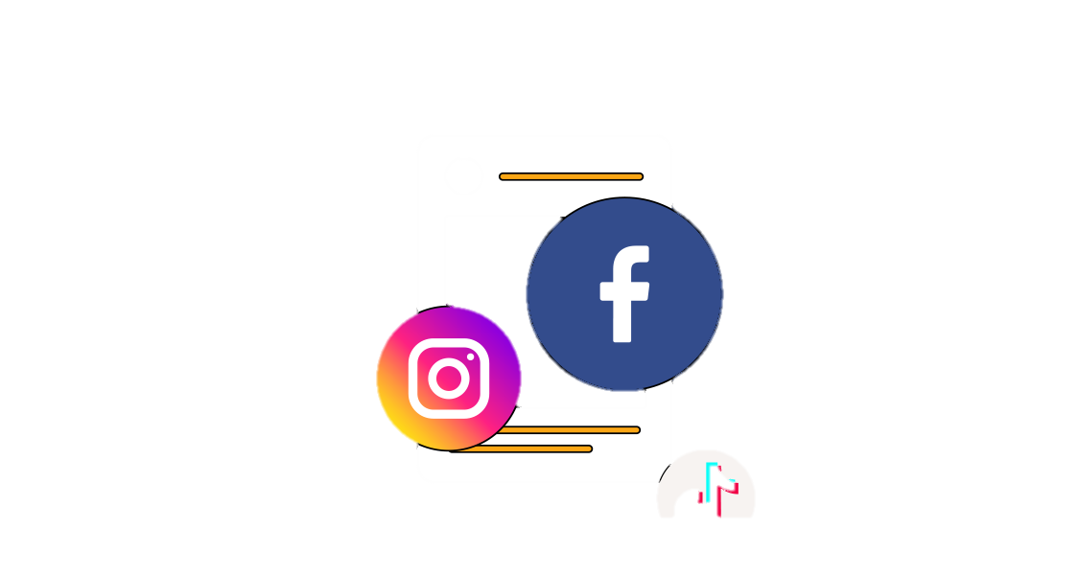

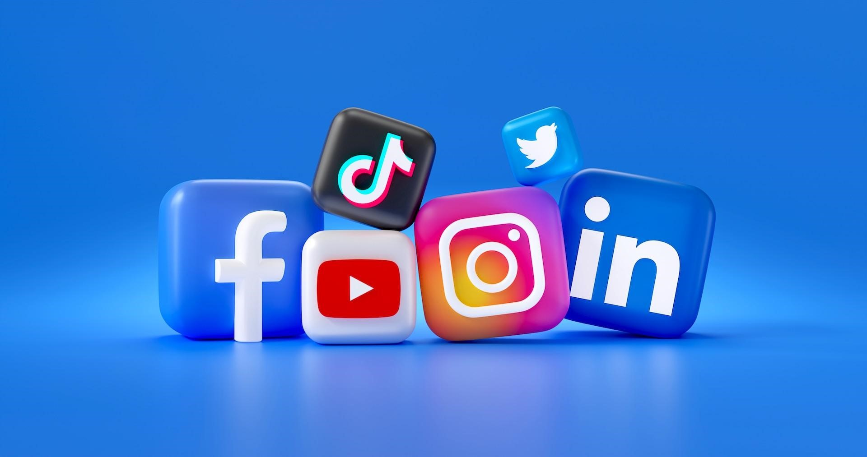
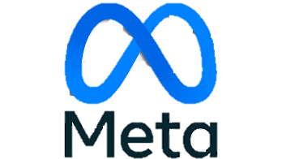
Instagram User’s Analysis

Slide 2

agenda
Introduction to Social Metaverse Company.
Data Schema And Cleaning.
Follower Analysis.
Users Activity and Engagement Analysis.
Hashtags affects on user engagement.
User Retention.
Ad Campaign Insights.
Conclusion.
Reference.

Slide 3
Social Metaverse Company: o. Social Media is a computer-based technologies that facilitates sharing of ideas, thoughts and information through virtual networks and communication. o. When Facebook launched in 2004, it changed the way people connect. Apps like messenger, Instagram and WhatsApp further empowered billions around the world. Now, meta is moving beyond 2D screens toward immersive experiences like augmented, virtual and mixed reality to help build the next evolution in social technology.

Slide 4
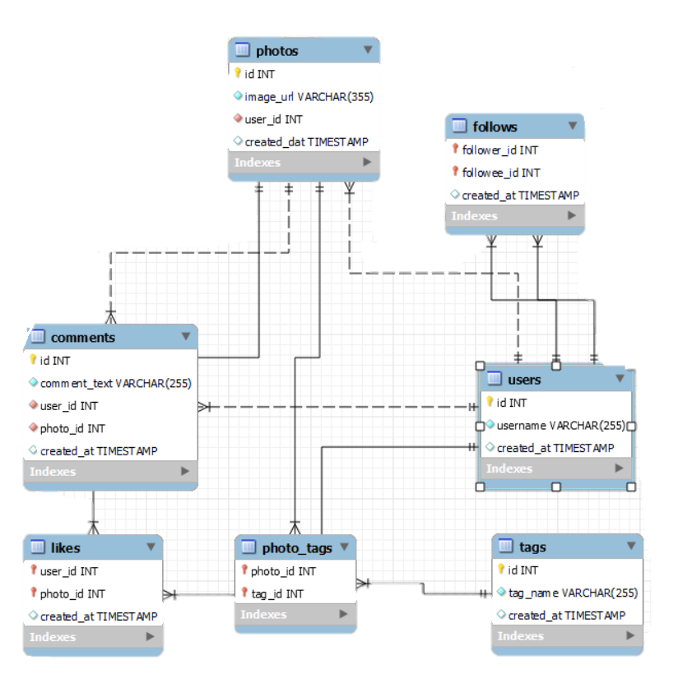
Data Cleaning -
Data was checked for Null And Duplicate Rows.
Categorial CTE’s are created for faster querying.
Duplicate Rows are removed if any present.
Database Schema

Slide 5

Follower Analysis -
The Users with No followee has the highest number of followers.
As per our data, the users are divided into two groups.
One with no followees are having 77 followers.
Another with 99 followees are having 76 followers.

Slide 6
Follower Analysis -
These Users have the tendencies to follow back after they are being followed.
These Users are beneficial for targeted campaings.

Slide 7
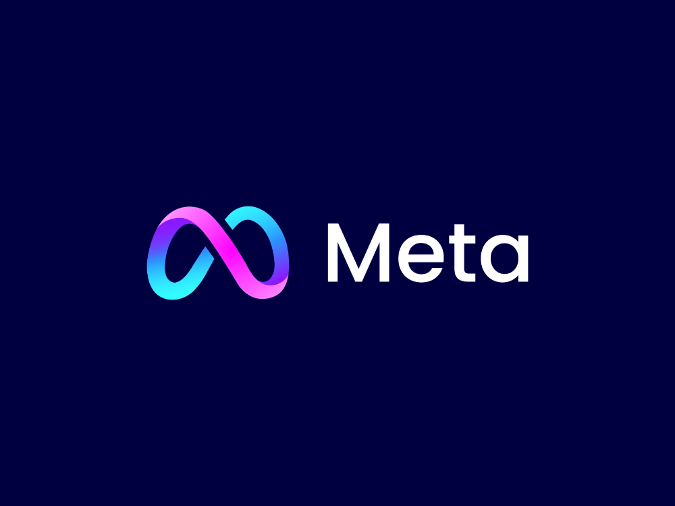
Users Activity level -
Most of the user’s lies in the mid-range of the activity level.
Higher the range of user’s activity higher is their interaction with the platform.
The count of users in the highest range of activity are low.

Slide 8
Users engagement rate -
The count of users are highest in the highest engagement rate.
In the month of October the rate of engagement is highest.

Slide 9
Inactive Users With no activity and engagement -
These users have no activity or engagement through out the year.
The accounts are created but there’s no historic data on these users

Slide 10
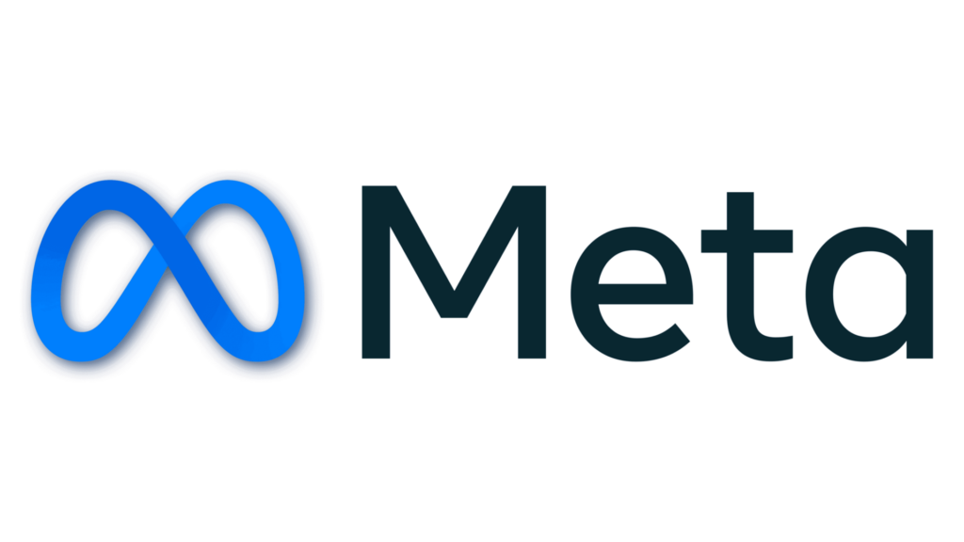
Hashtags affects On users engagement
Hashtag Affects Each Users Posts Engagement.
Each hashtag has it’s own specific engagement based on likes and comments.

Slide 11

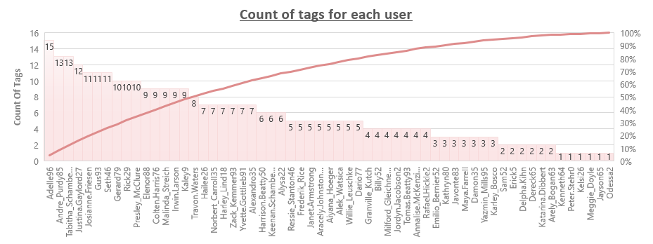
The count of tags used by users are correlated to the count of posts.
Smile tag has the highest engagement rate.
Dreamy is the highest average liked tag.

Slide 12

The tag_names used by the users are specific for each user and directly related to the count of posts published by them.
This data helps us decide which content to suggest the users for better engagement in the platform.
The tag_name ‘smile’ with the highest engagement i.e the total of likes and comments as well as the count of uses are the maximum for this tag.

Slide 13
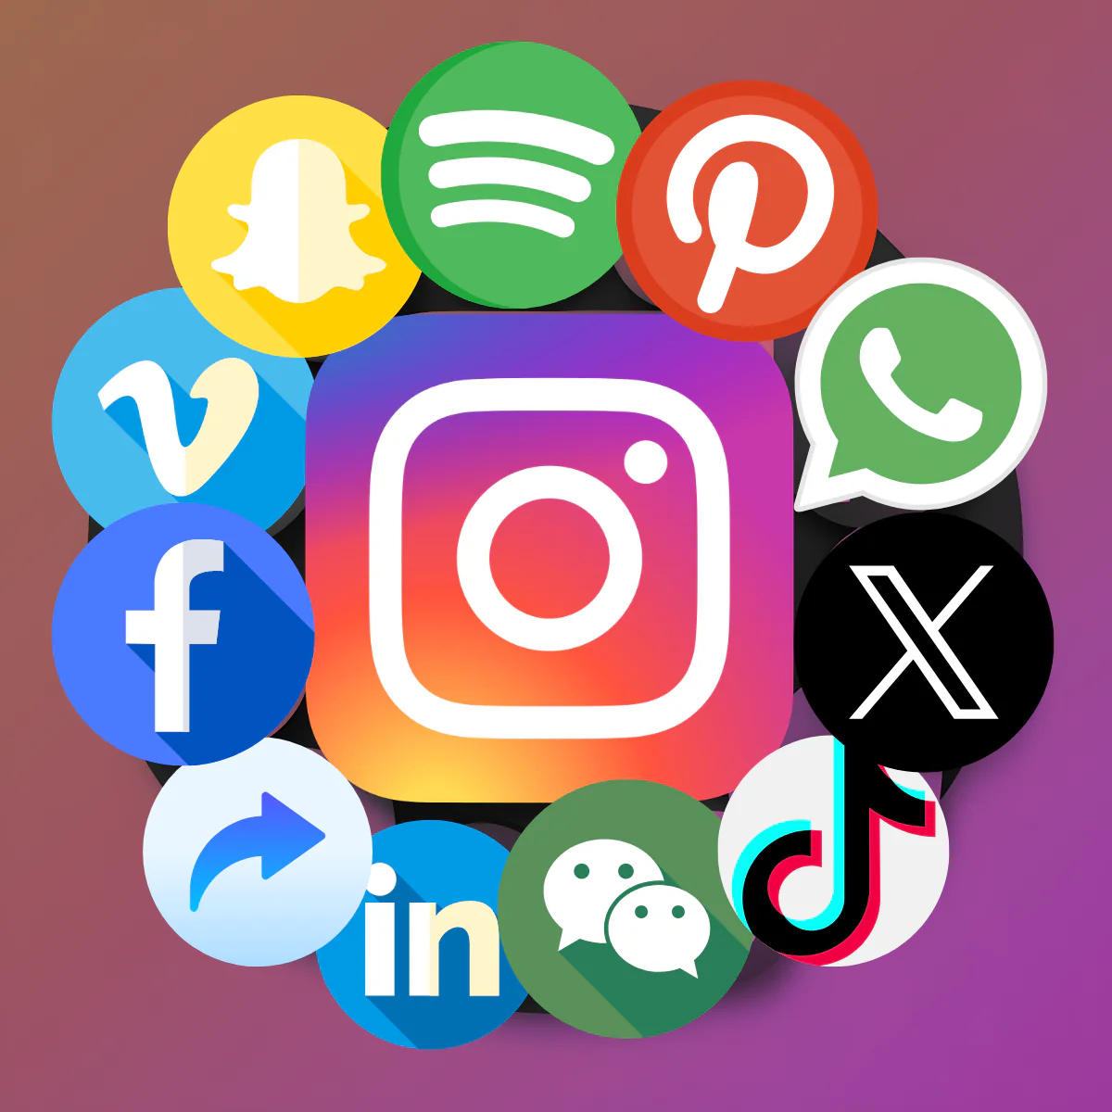
User Retention Analysis:-
1-10
11-20
21-30
This group of users are our most loyal users.
This group of users are our valuable users.
This group of users are least engaged users.

Slide 14

User Retention Insights:-
For Loyal Users –
We can reward the users by providing discounts on ad campaigns so that we can get higher user retention rate.
For Valuable Users –
We can provide them with higher account presence or reach and also a small discounts in payment of ad campaigns.
For Least Engaged Users –
We can send some push notification with platforms new features and top users ad campaigns and post suggestion based on their historic data.
Ranking Bracket | Count of users
1-10 (Loyal Users) | 10
11-20 (Valuable Users) | 10
21-30 (Least Engaged Users) | 12
Grand Total | 32

Slide 15
Ad Campaign insights:-
The users with rankings 1 to 5 are the most ideal candidates for influencer marketing campaigns as they have highest follower count and highest engagement rate.
We can target specific marketing campaigns or personalized recommendations based on the most engaged hashtag of each user.

Slide 16

CONCLUSION
USER BEHAVIOUR AND RETENTITION –
Analyzed follow activity of users and found a pattern of users who follow backs after they are being followed by that exact user. We can focus on the earlier recommendations to strategized for having a higher user retention and also for making least engaged users more engaged.
USER ACTIVITY AND ENGAGEMENT ON AD CAMPAIGN –
Analyzed users activeness and engagement through likes, comments and their count of posts in the platform. Based on their activity and engagement with specific hashtags we can personalize the type of content they prefer which will increase the engagement on the platform and target specific ad campaigns.

Slide 17
REFERENCES –
TA Session with Akshat Raj and Ruchita Shaha.
META Website.

Slide 18
Thank you

